Slide 1
Hash
Hash Functions
  condense arbitrary size message to fixed size
  by processing message in blocks
  through some compression function
  either custom or block cipher based
Notes:
Now look at important examples of both secure hash functions and message authentication codes (MACs).
Traditionally, most hash functions that have achieved widespread use rely on a compression function specifically designed for the hash function. Another approach is to use a symmetric block cipher as the compression function.
MACs also fall into two categories: some use a hash algorithm such as SHA as the core of the MAC algorithm, others use a symmetric block cipher in a cipher block chaining mode.

Slide 2
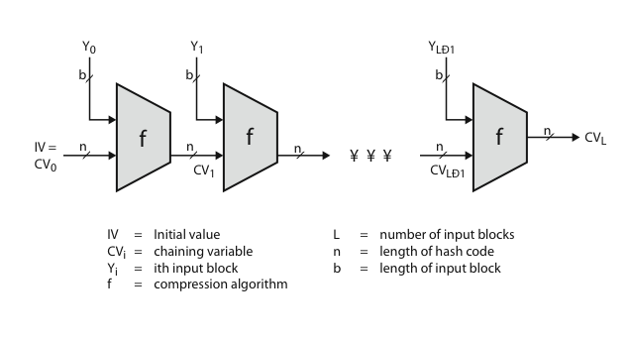
Hash Algorithm Structure
Notes:
Most important modern hash functions follow the basic structure shown in this figure, Stallings Figure 11.9. This has proved to be a fundamentally sound structure, and newer designs simply refine the structure and add to the hash code length. Within this basic structure, two approaches have been followed in the design of the compression function, as mentioned previously, which is the basic building block of the hash function.

Slide 3
Secure Hash Algorithm
SHA originally designed by NIST & NSA in 1993
was revised in 1995 as SHA-1
US standard for use with DSA signature scheme
  standard is FIPS 180-1 1995, also Internet RFC3174
  nb. the algorithm is SHA, the standard is SHS
based on design of MD4 with key differences
produces 160-bit hash values
recent 2005 results on security of SHA-1 have raised concerns on its use in future applications
Notes:
The Secure Hash Algorithm (SHA) was developed by the National Institute of Standards and Technology (NIST) and published as a federal information processing standard (FIPS 180) in 1993; a revised version was issued as FIPS 180-1 in 1995 and is generally referred to as SHA-1. The actual standards document is entitled Secure Hash Standard. SHA is based on the hash function MD4 and its design closely models MD4. SHA-1 produces a hash value of 160 bits. In 2005, a research team described an attack in which two separate messages could be found that deliver the same SHA-1 hash using 2^69 operations, far fewer than the 2^80 operations previously thought needed to find a collision with an SHA-1 hash [WANG05]. This result should hasten the transition to newer, longer versions of SHA.

Slide 4
Revised Secure Hash Standard
NIST issued revision FIPS 180-2 in 2002
adds 3 additional versions of SHA
  SHA-256, SHA-384, SHA-512
designed for compatibility with increased security provided by the AES cipher
structure & detail is similar to SHA-1
hence analysis should be similar
but security levels are rather higher
Notes:
In 2002, NIST produced a revised version of the standard, FIPS 180-2, that defined three new versions of SHA, with hash value lengths of 256, 384, and 512 bits, known as SHA-256, SHA-384, and SHA-512. These new versions have the same underlying structure and use the same types of modular arithmetic and logical binary operations as SHA-1, hence analyses should be similar. In 2005, NIST announced the intention to phase out approval of SHA-1 and move to a reliance on the other SHA versions by 2010. See Stallings Table12.1 for comparative details of these algorithms.

Slide 5
MD5
MD5 processes a variable-length message into a fixed-length output of 128 bit. The input message is broken up into chunks of 512-bit blocks (sixteen 32-bit words); the message is padded so that its length is divisible by 512. The padding works as follows: first a single bit, 1, is appended to the end of the message. This is followed by as many zeros as are required to bring the length of the message up to 64 bits fewer than a multiple of 512. The remaining bits are filled up with 64 bits representing the length of the original message, modulo 2⁶⁴

Slide 6
MD5
The main MD5 algorithm operates on a 128-bit state, divided into four 32-bit words, denoted A, B, C and D. These are initialized to certain fixed constants. The main algorithm then operates on each 512-bit message block in turn, each block modifying the state. The processing of a message block consists of four similar stages, termed rounds; each round is composed of 16 similar operations based on a non-linear function F, modular addition, and left rotation. Following Figure illustrates one operation within a round. There are four possible functions F; a different one is used in each round:

Slide 7
MD5
denote the XOR, AND, OR and NOT operations respectively.

Slide 8
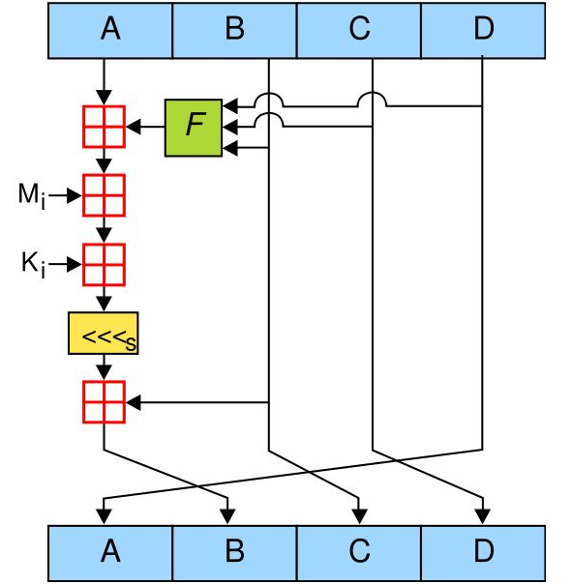
MD5

Slide 9
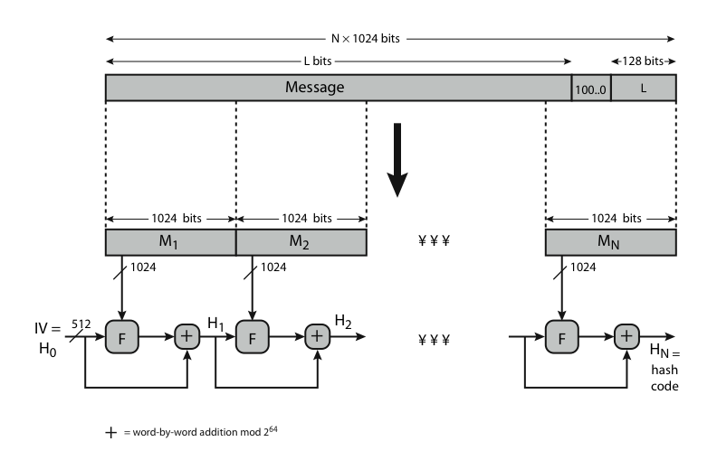
SHA-512 Overview
Notes:
Now examine the structure of SHA-512, noting that the other versions are quite similar.
SHA-512 follows the structure depicted in Stallings Figure 12.1. The processing consists of the following steps:
• Step 1: Append padding bits
• Step 2: Append length
• Step 3: Initialize hash buffer
• Step 4: Process the message in 1024-bit (128-word) blocks, which forms the heart of the algorithm
• Step 5: Output the final state value as the resulting hash
See text for details.

Slide 10
SHA-512 Compression Function
heart of the algorithm
processing message in 1024-bit blocks
consists of 80 rounds
  updating a 512-bit buffer
  using a 64-bit value Wt derived from the current message block
  and a round constant based on cube root of first 80 prime numbers
Notes:
The SHA-512 Compression Function is the heart of the algorithm. In this Step 4, it processes the message in 1024-bit (128-word) blocks, using a module that consists of 80 rounds, labeled F in Stallings Figure 12, as shown in Figure 12.2. Each round takes as input the 512-bit buffer value, and updates the contents of the buffer. Each round t makes use of a 64-bit value Wt derived using a message schedule from the current 1024-bit block being processed. Each round also makes use of an additive constant Kt, based on the fractional parts of the cube roots of the first eighty prime numbers. The output of the eightieth round is added to the input to the first round to produce the final hash value for this message block, which forms the input to the next iteration of this compression function, as shown on the previous slide.

Slide 11
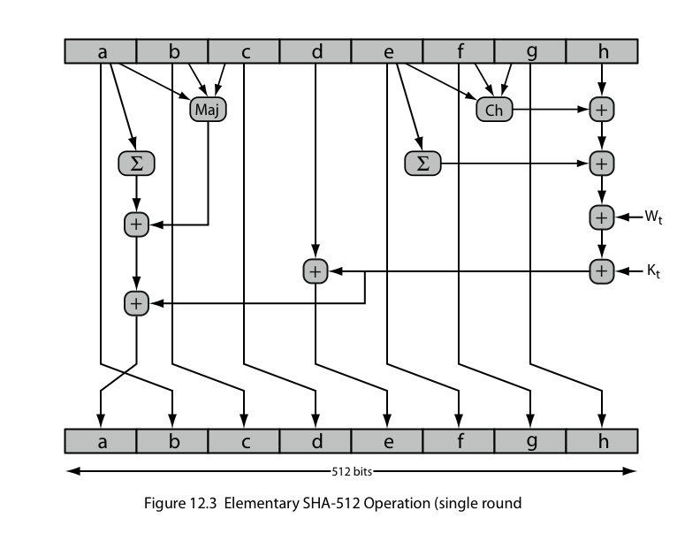
SHA-512 Round Function
Notes:
The structure of each of the 80 rounds is shown in Stallings Figure 12.3. Each 64-bit word shuffled along one place, and in some cases manipulated using a series of simple logical functions (ANDs, NOTs, ORs, XORs, ROTates), in order to provide the avalanche & completeness properties of the hash function. The elements are:
Ch(e,f,g) = (e AND f) XOR (NOT e AND g)
Maj(a,b,c) = (a AND b) XOR (a AND c) XOR (b AND c)
∑(a) = ROTR(a,28) XOR ROTR(a,34) XOR ROTR(a,39)
∑(e) = ROTR(e,14) XOR ROTR(e,18) XOR ROTR(e,41)
+ = addition modulo 2^64
Kt = a 64-bit additive constant
Wt = a 64-bit word derived from the current 512-bit input block.

Slide 12
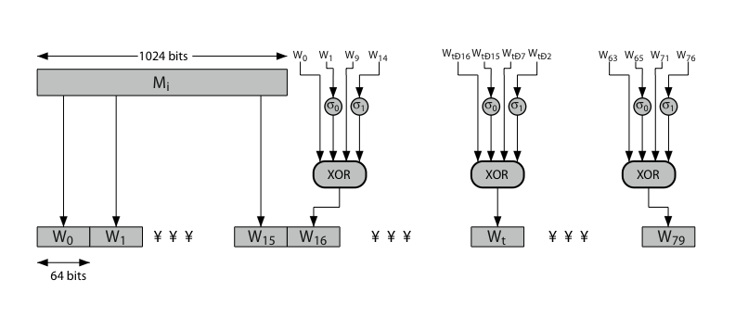
SHA-512 Round Function
Notes:
Stallings Figure 12.4 details how the 64-bit word values Wt are derived from the 1024-bit message. The first 16 values of Wt are taken directly from the 16 words of the current block. The remaining values are defined as a function of the earlier values using ROTates, SHIFTs and XORs as shown. The function elements are:
∂0(x) = ROTR(x,1) XOR ROTR(x,8) XOR SHR(x,7)
∂1(x) = ROTR(x,19) XOR ROTR(x,61) XOR SHR(x,6).

